Slide 1
Writing a Good Research Paper
- Reviewer’s Perspective
Prof. J. P. Verma
M.Sc. (Statistics), PhD, MA(Psychology), Masters(Computer Application)
Vice Chancellor
Sri Sri Aniruddhadeva Sports University
(A State University of Govt. of Assam)
Chabua, Dibrugarh, Assam
Email: vermajprakash@gmail.com
web: jpverma.org

Slide 2
Research Objectives
To develop a theory through inductive logic
To test a theory through deductive logic

Slide 3
How theories are developed?
By observing a phenomenon
Example
If number of patients starts arriving more in numbers in the health centre their must be a outbreak of some disease
If most of the sports persons are medal winners from a particular university their training program may be superior than the other universities.

Slide 4
How Theories are tested ?
By means of Hypothesis
Example
The exercise intensity with 65% maximum heart rate may
improve the cardio- respiratory endurance significantly.

Slide 5
Objective and Research Questions
Objective
Broader Theme of Paper
Research Questions:
More specific
Issues regarding which the answer is required

Slide 6
Statistical Processes
Different methods of analyzing data
Types of Processes
Descriptive
Comparative
Relationship
Inferential
Predictive

Slide 7
Delimitations and Limitations
Delimitations
Reducing size of the problem
Restricting parameters to be investigated
Limitations
Things which are beyond the control of the researchers
Better control
Reduced variability
Accurate findings
Advantage of Delimiting the Study

Slide 8
Types of Data
Data Types
Non-metric
Metric
Nominal
Ordinal
Interval
Ratio
Use Non-parametric tests
Use Parametric tests
Requires less assumption
Requires specific assumptions
Data to come from normal population
Low
Level of measurement
High
Lowest
Information about phenomenon
Highest

Slide 9
Detect Outlier
A data which is unusual
How to detect ?
Most of the behavioral variables are normally distributed if selected randomly
And therefore
If a random sample is drawn then any score that lies outside 3σ or 2σ limits is an outlier
If population mean, µ is 40 and standard deviation,σ is 5 then
Any value outside the range 30 to 50 or outside the range 25 to 55 may be an outlier

Slide 10
How Outliers May Spoil the Findings
X Y
1 5
2 4
3 3
4 2
5 1
X Y
1 5
2 4
3 3
4 2
5 1
95 98
r = -1
r = .997

Slide 11
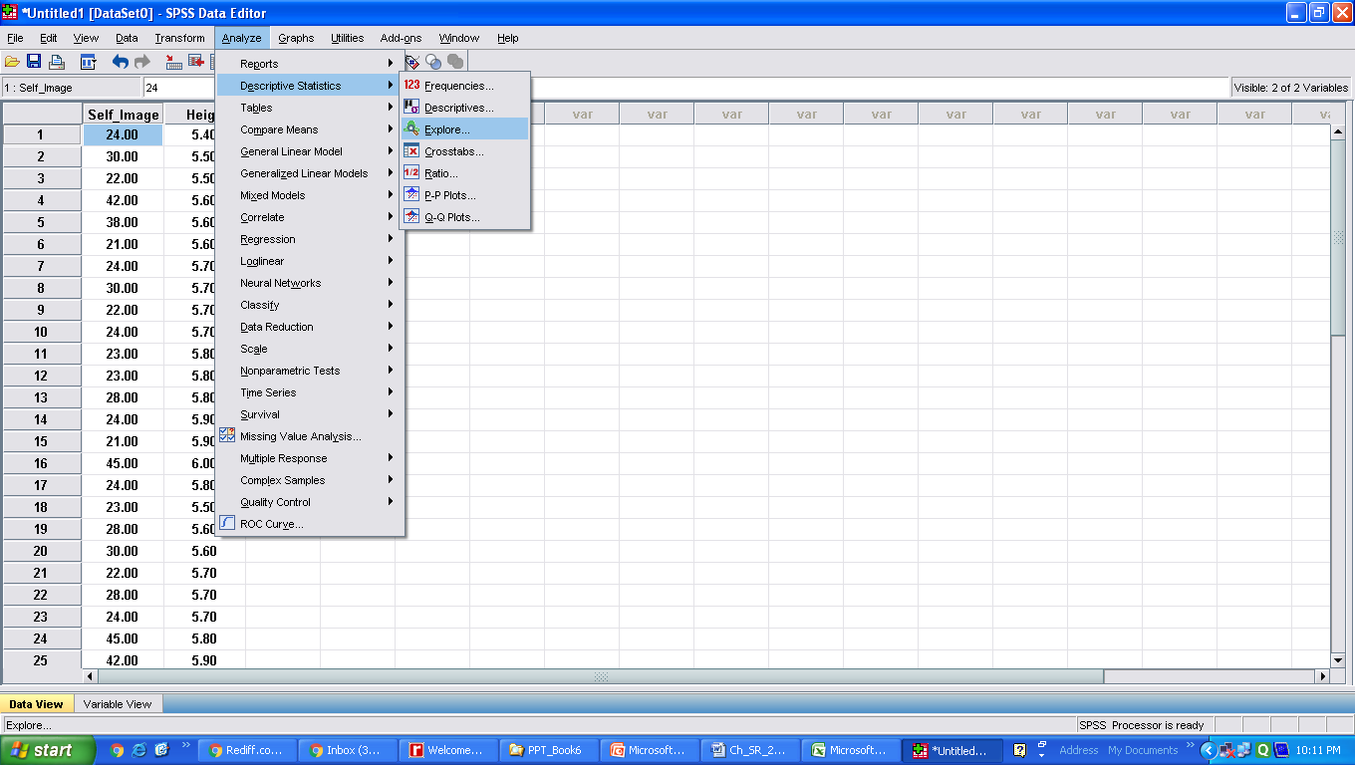
Detecting Outliers with SPSS
Self image (in nos.) Height(in ft.)
24.00 5.40
30.00 5.50
22.00 5.50
48.00 5.60
38.00 5.60
21.00 5.60
24.00 5.70
30.00 5.70
22.00 5.70
24.00 5.70
23.00 5.80
23.00 5.80
28.00 5.80
24.00 5.90
21.00 5.90
56.00 6.00
24.00 5.80
23.00 5.50
28.00 5.60
30.00 5.60
22.00 5.70
28.00 5.70
24.00 5.70
40.00 5.80
42.00 5.90
1
In the Data View click the following commands in sequence
Analyze Descriptive statistics Explore

Slide 12
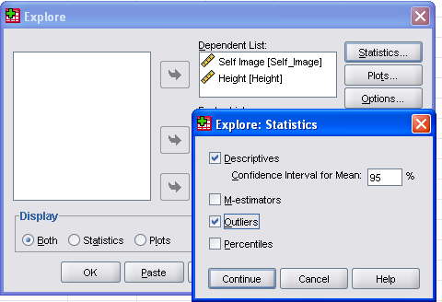
Detecting Outlier with SPSS
2
Bring all the variables at this location
Click on Statistics for outlier
3
4
Check this option for Outlier
6
Click on OK for output
5
Click on Continue

Slide 13
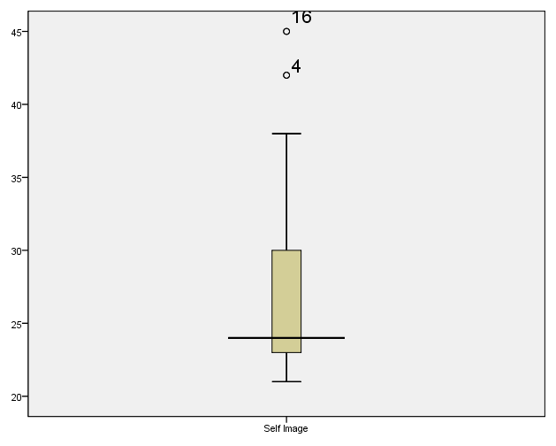
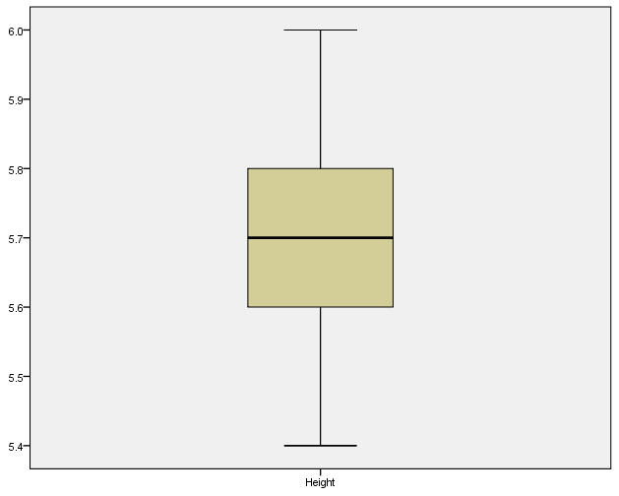
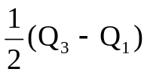

Identifying Outliers Through Boxplot
B
SPSS identifies outlier if data is
less than A or more than B
Q₃
Median
A= Q₁ -
Q₁
B= Q₃ +
A
4th and 16th data of self image are outliers

Slide 14
What if the Assumptions Violate
Assumptions in Computing Average
____________________________________________________
Nature of variable Suitable central tendency
____________________________________________________
Nominal data (Categorical) Mode
Ordinal data Median
Interval/Ratio Mean
(Symmetrical or nearly symmetrical)
Interval/Ratio (skewed) Median
____________________________________________________
Non-metric
Non-parametric
Parametric
Metric
Non-parametric

Slide 15
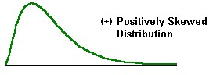
What if the Assumptions Violate
An Example
Marks of the students in an examination
____________________________________________________
Student: 1 2 3 4 5 6 7 8 9 10
Marks: 35 40 30 32 35 39 33 32 91 93
____________________________________________________
Mean =46
But most of the scores are less than 46
Median = 35
A most representative value of average

Slide 16
What if the Assumption of Normality Violates
Marks(X)
3.0
4.0
4.0
5.0
6.0
5.0
6.0
4.0
5.0
7.0
6.0
7.0
4.0
5.0
7.0
12.0
6.0
12.0
15.0
14.0
Illustration Consider the marks obtained by the students in mathematics as shown in the table. Can it be concluded that the sample has been drawn from the population having mean 8. We wish to test H₀:µ=8 against H₁: µ≠8.
Parametric test: t Test
t-table for the data on mathematics marks
t df Sig.(2-tailed) Mean Diff.
-1.464 19 .160 -1.15000
Test value = 8
H₀ is NOT rejected
Test of normality : Shapiro-Wilk test
Statistic df Sig.
X .823 20 .002
Non-parametric test: Sign test
Marks: 3 4 4 5 6 5 6 4 5 7 6 7 4 5 7 12 6 12 15 14
Sign: - - - - - - - - - - - - - - - + - + + +
Number of ‘+’ sign = 4, Number of ‘–‘ sign = 16, N= Number of scores = 20
Test statistic(X) = No. of fewer sign = 4. Critical value for X(fewer signs) for n =20 at 5% level = 5.
Since X (= 4) is less than the critical value 5, the H₀ is rejected and therefore it may be concluded that the mean of the distribution is not 8.

Slide 17
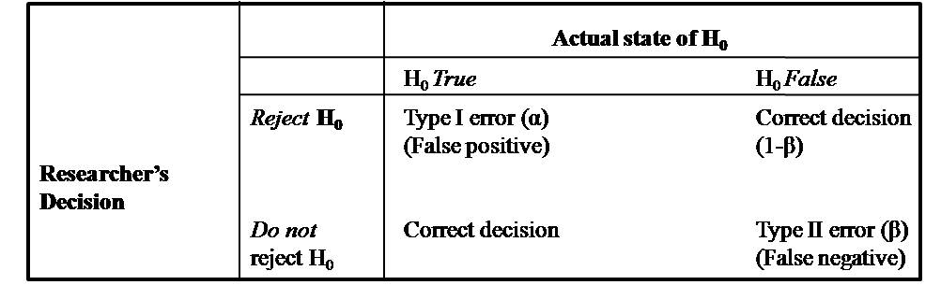
Hypothesis Development
Develop Hypothesis as per the Research Questions
Hypothesis can be one tailed or two tailed
Understanding Statistical Errors

Slide 18
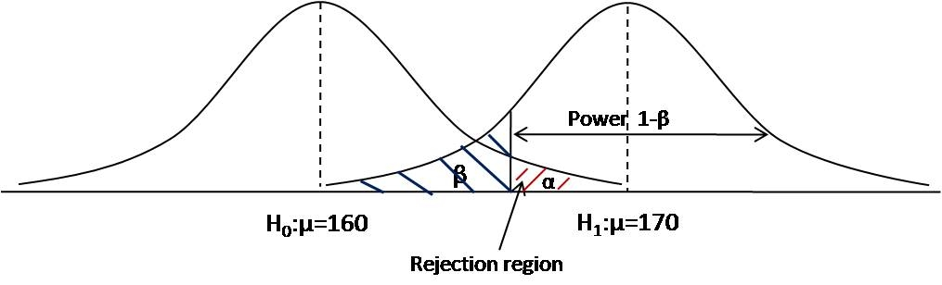
Understanding Relation between α and β

Slide 19
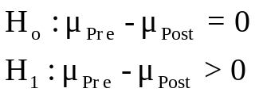

Authenticity Issues in Experimental Research
Issues of: Ethics, Effect Size, Sample Size, and Research Design
Research question: Whether four-week health awareness program is effective in
reducing weight of the housewives
Control: Women of 40-50 yrs age category, more than 80 Kg weight
Pre_Weight Post_Weight
88 87
87 84
81 78
89 91
84 80
91 88
85 83
83 80
82 81
86 82
1.
2. Level of significance(α) = .05
3. Test statistic
4. t_{.05}(9)=1.833
5. Result: Since Cal t(=3.836) > 1.833, H₀ is rejected
Inference: The health awareness program is effective in reducing the weight of housewives.
Issues to be debated
Can the result be generalized for any weight category?
On average how much weight reduction?
How many samples should be taken to conclude at a 5% significance level
Can we say that the weight reduction is due to the health awareness program?

Slide 20
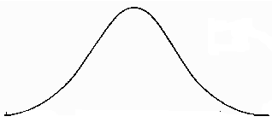




Enhancing Authenticity in Experimental Research
Fixing Boundary Conditions
Write null and alternative hypotheses
Decide whether to test a one-tailed or two-tailed hypothesis.
Decide the level of significance(α) .10, .05 or .01
Decide β (0.2 or less)
Decide minimum detectable difference (d)
Non-rejection
region
Rejection region
area = α/2
Find an estimate of variance from
similar studies in reviews (σ)
Find sample size (n) using formula or G*Power software
Critical values
Select a statistical test like z or t and test their assumptions
Find the critical value or depending upon one or two-tailed tests respectively.
If Cal. z > reject the null hypothesis at 5% level with power (1-β)
otherwise do not reject it.
Requirement for Deciding Sample Size with G*Power
Whether One-tailed/two-tailed Hypothesis
Alpha level
Power (1-β), minimum 80%
4. Minimum detectable difference (d)
5. Variability of population (σ)
Effect Size: d/σ

Slide 21
Determine Sample Size in your Study
Why Sample Size
Matters in Research?

Slide 22


A Mystery to Be Solved
Research Question: Whether Height of the students in High socio economic
status is higher than that of low socio economic status?
Large sample will reject the null hypothesis
even for a small difference in means
Whereas
Small sample may not reject the null hypothesis
Hence
Researcher is in dilemma as to what should be the sample size

Slide 23
Intricacies of Sample size
Large Sample
Small Sample
Wastage of resources
More Time and money
Smaller significant difference may not be of any practical utility
Unnecessary exposure of many to hazardous situations
Less reliable estimate
Fail to detect difference
The study may require repetition
What’s the solution
Choose optimum sample size which gives
Desired precision of estimate or
Desired power in hypothesis testing experiment

Slide 24
Two approaches to sample size calculations
A. Precision-based
Used in Survey research
With what precision you want to estimate the proportion, mean (or whatever you are measuring)
B. Power based
Used in Hypothesis Testing experiment
How small a difference is important to detect and with what degree of certainty?

Slide 25
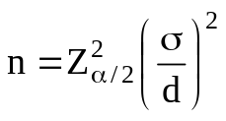
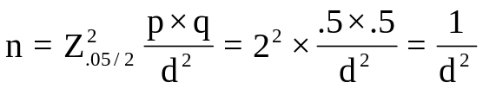

Determine Sample Size in Survey Studies
In Estimating Mean
d = Difference between true and estimated mean
Remark: In one tailed test use Z_{α} instead of Z_{α/2}
d = Difference between true and estimated proportion
In Estimating Proportion
Taking
p=q=.5 for maximum variance
If 10% precision is required, d = .1 Required n = 100
Precision d n
10% .1 100
5% .05 400
3% .01 1112
1% .01 10000

Slide 26
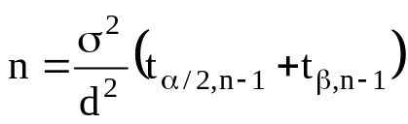
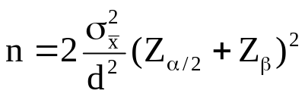
Determine Sample Size in
Hypothesis Testing Experiment
In One Sample Test
Remark: In one tailed test use t_{α,n-1} and Z_{α} instead of t_{α/2,n-1} and Z_{α/2} respectively
In Two Sample Test
Determination of Sample Size and Power Analysis
with G*Power Software
Available at Kindle and in Paperback on AMAZON

Slide 27
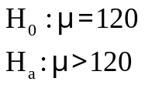
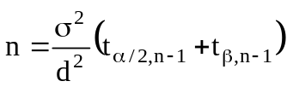


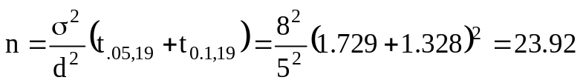



Computing Sample Size in One sample Test
-An Example
One tailed test
Problem: What should be the sample size to reject the null hypothesis in testing whether mean population systolic blood pressure is greater than 120 units. Given the population σ of systolic BP as 8, α=.05, power=.9 and detectable difference required is 5 unit.
Hypotheses
Given
Power=0.9
α=.05
σ=8
d = 5
We know
Let us assume n=20, then
Now assume n=24, as an estimate then
and
Thus, sample of size 24 is required to detect the
difference of 5 units in BP with 90% power

Slide 28
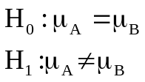





Determination of Sample Size in Two Sample Tests
Two Tailed Test
-A Solved Example
Objective: What should be the sample size to detect 800 counts difference between the effectiveness of two drugs on increasing WBC counts with power 0.9 at 5% level. Given that the standard deviation of the WBC in the similar studies is 1800.
Given d= 800, σ = 1800, α=.05, Power =0.9
We need to find n = ?
β=1 - .9 =.1
= 106.2882
Conclusion: Each sample should have 107 data
If available sample in one group is , n₁=100
Then
Thus if n₁=100 then n₂ should be 115 to retain the same power in the study

Slide 29
Purpose of Empirical Research?
To investigate some kinds of relationship between
independent and dependent variables.

Slide 30
Types of Empirical Research
Non Experimental or Correlational
Lacks cause and effect relationships
Less internal validity
Experimental
Explain cause and effect relationships
More internal validity

Slide 31
Explanation of Terms
Aerobic exercise with different intensity
Cardio Respiratory Endu
To see the effect of
on
in
Housewives
the
Treatments: Intensities of aerobic exercise
Dependent variable
Subjects

Slide 32
Terminologies in Design of Experiment
External validity
Extent of generalizability of findings to the population from which sample has been drawn.
Internal Validity
Extent to which one can say that the variation observed in the Dependent variable(DV) is due to the variation in the Independent variable(IV).

Slide 33
Controlling Variance in
Experimental Study
Purpose of Experimental Design
Maximize Systematic Variance
Control Extraneous Variance
Minimize Error Variance

Slide 34
Controlling Variance in Experimental Design
- An Example
Objective: To Test the Effect of Teaching methodology on Performance
Systematic variance
Traditional Method
T₁
Audio-visual Method
T₂
Flexible method
T₃
6
7
5
2
Low IQ
Mixed IQ
9
8
7
7
High IQ
5
4
3
2
Extraneous variance: IQ
Error variance

Slide 35
Controlling Systematic Variance
Example :
Compare the effect of different class durations on the participant’s fatigue
How to maximize?
IV: Class duration
T1, T2, T3
Variability in DV due to manipulation of IV
DV: Fatigue
Make levels of independent variables as distinct as possible
Which one you will choose?
T1
T2
T3
Case 1
50 min 55 min 60min
Case 2
45 min 60 min 75 min

Slide 36
Extraneous Variance
Methods of Controlling Extraneous Variance
Non-Statistical Procedures
Randomization
Elimination
Matching
Statistical Procedures
Blocking
Repeated measures design
ANCOVA design

Slide 37
Randomization
- Controlling Extraneous Variance
A powerful method of controlling the effect of extraneous variable
Strategy
Always draw random Sample
Allocate treatments randomly to the subjects
Outcome
Enhancing external and internal validity
Removing the confounding effect

Slide 38
Elimination Method
- Controlling Extraneous Variance
Controlling the Effect of extraneous variable through its elimination
Strategy
Eliminate extraneous variable that affects the
dependent variable
Drawback
The findings can not be generalized
Which extraneous variable you will choose to eliminate?
Example 1: Effect of advertisement on sale of cosmetics
Example 2: Effect of exercise on strength

Slide 39
Matching Group Method
- Controlling Extraneous Variance
Example:
To observe the effect of the herbal compound on weight gain at
three different intensities (T1, T2, and T3).
Strategy:
Match the groups on some extraneous variable to control for potential confounding factors
Allocation of treatments to the subjects
Sub. Wt.
S1 39
S2 40
S3 40
S4 41
S5 42
S6 43
S7 44
S8 46
S9 47
S10 48
S11 49
S12 50
S2
S1
S3
T₁
T₃
T₂
Matching has been done based on weight to ensure balanced groups in the study
S4
S6
S5
T₂
T₃
T₁
Treatment Groups
S7
S8
S9
T1
S2
S5
S7
S10
T2
S3
S4
S8
S11
T3
S1
S6
S9
S12
T₁
T₂
T₃
S12
S10
S11
T₃
T₁
T₂
Treatments
Figure 1.5 Allocation of treatments by matching the subjects

Slide 40
Statistical Control
If the non-experimental procedure is not sufficient, statistical control is used
What do we do?
Control by making Blocks
Use repeated measure design
Use ANCOVA design

Slide 41
Blocking
- Including Additional Independent Variable in Design
Objective: To Test the Effect of Teaching methodology on Performance
Systematic variance
Traditional Method
T₁
Audio-visual Method
T₂
Flexible method
T₃
6
7
5
2
Low IQ
Mixed IQ
9
8
7
7
High IQ
5
4
3
2
Extraneous variance: IQ
Error variance

Slide 42


Understanding The Effect of Blocking
Distribution of MSS
CRD
RBD
Block
11.06
Error
Bet. Group
4.64
11.06
Bet. Group
Inter.
Error
2.11
Advantage of Blocking:
If variability among subjects exists F maximizes due to blocking which facilitates the researcher to show the effect of an intervention

Slide 43
Repeated Measures Design
- For controlling Extraneous variance
Type 1: The same subjects are tested in each treatment condition
Example:
Effect of Treatment (morning, afternoon and evening) on the memory retention
Type 2: The same subjects are tested for different durations during treatment
Example
The effect of duration (morning, afternoon, and evening) on learning
outcomes in the course
Example
The effect of duration (morning, afternoon, and evening) and teaching methods (traditional, audio-visual, and flexible) on learning outcomes in the course.
Features
Subject receives treatment in a random fashion
Experimental error reduces as subjects act as their control.

Slide 44
ANCOVA Design
- For controlling Extraneous variance
What is ANCOVA
A statistical design in which error variance is minimized by eliminating the effect of a covariate that influences the response variable.
When to Use
A situation where treatments cannot be randomly assigned to subjects.
Researchers may not have the option to assign treatments randomly to subjects.
Error Control
ANCOVA design controls the effect of covariates by adjusting the final scores on the criterion variable.

Slide 45
Sources of Error Variance
First: Measurement Error
Second: Individual variations
Minimizing error variance
By Experimental procedure
Clear Instructions
Standard equipments

Slide 46
Minimizing Error Variance
Controlling Individual Variations
Non-experimental procedures
Statistical procedures
Also reduces Error variance

Slide 47
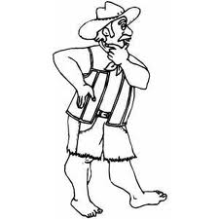
Consequences of not Controlling Error Variance
What if error variance is not controlled?
Effect of external variable is confounded with experimental variable
Can’t say that effect is because of intervention

Slide 48
Benefit of controlling different variances
Maximizing Systematic Variance
Controlling Extraneous Variance
Minimizing Error
Variance
Facilitates experimenter
To compare Systematic Variance against Error Variance
Strategy:
Minimize error variance to give systematic variance a chance to show the significance.

Slide 49
Thank You for Your Attentive Listening

Slide 50

Research & Statistics Resources of
Prof. J. P. Verma
Vice Chancellor
Sri Sri Aniruddhadeva Sports University, Chabua
(A State University of Assam)
Email: vermajprakash@gmail.com
www.jpverma.org
For Details About the Book
CLICK HERE
BACK

Slide 51

Research & Statistics Resources of
Prof. J. P. Verma
Vice Chancellor
Sri Sri Aniruddhadeva Sports University, Chabua
(A State University of Assam)
Email: vermajprakash@gmail.com
www.jpverma.org
For Details About the Book
CLICK HERE
BACK

Slide 52
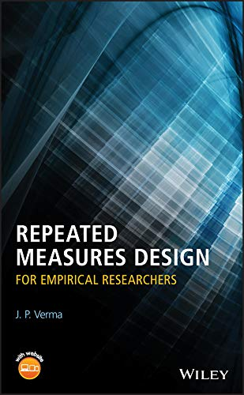
Research & Statistics Resources of
Prof. J. P. Verma
Vice Chancellor
Sri Sri Aniruddhadeva Sports University, Chabua
(A State University of Assam)
Email: vermajprakash@gmail.com
www.jpverma.org
For Details About the Book
CLICK HERE
BACK

Slide 53
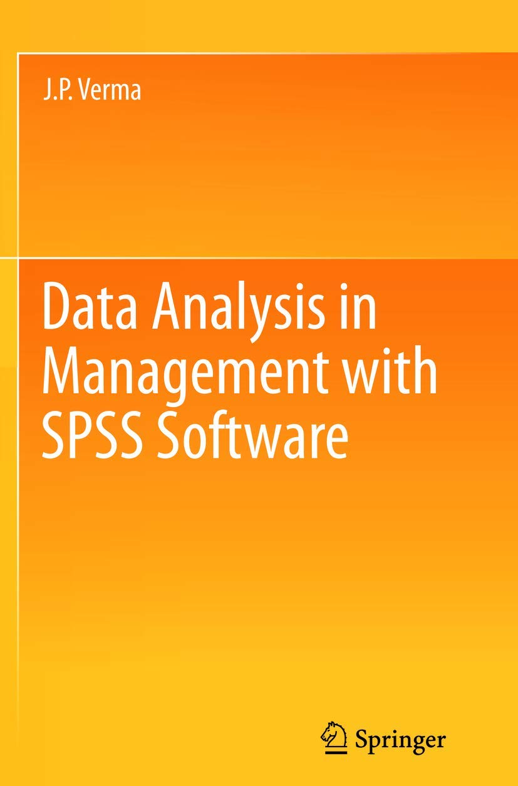
Research & Statistics Resources of
Prof. J. P. Verma
Vice Chancellor
Sri Sri Aniruddhadeva Sports University, Chabua
(A State University of Assam)
Email: vermajprakash@gmail.com
www.jpverma.org
For Details About the Book
CLICK HERE
BACK

Slide 54
Controlling Variance in Experimental Design
- An Example
Effect of herbal drug on hemoglobin in 4-week experiment
Systematic variance
50 mg drug
T₁
100 mg drug
T₂
150 mg drug T₃
Mixed age
Smaller age
15
17
45
46
16
19
15
19
Higher age
59
49
47
52
Extraneous variance: Age
Error variance

Slide 55
Blocking
- Including Additional Independent Variable in Design
Used when the matching is not possible
Experiment : To compare the effect of different dozes of herbal drug on hemoglobin
in a 4-week experiment
Herbal drug
50 mg drug
T₁
100 mg drug
T₂
150 mg drug T₃
Treatment Groups
T₁ T₂ T₃
16 15 16
17 19 18
22 22 21
24 23 24
Block 1
15 (T₂)
17 (T₁)
22 (T₁)
23 (T₂)
16 (T₃)
19 (T₂)
21 (T₃)
24 (T₃)
16 (T₁)
18 (T₃)
22 (T₂)
24 (T₁)
Extraneous variance: Age
Block 1
Block 1
Block 1
Age is a blocking variable

Slide 56
Systematic Variance
Variability in DV due to manipulation of IV
How to maximize ?
Make levels of independent variable as distinct as possible
Example :
Compare the effect of different doses of a herbal drug on hemoglobin
Which one you will choose ?
Case 1
50 mg 52 mg 54 mg
Case 2
50 mg 100 mg 150 mg

Slide 57
Procedure of Matching
- Controlling Extraneous Variance
A Non-Experimental Design Procedure
Approach
Match the group on the basis of dependent variable or some other suitable variable
On which variable matching should be done?
Example 1: Effect of teaching methods on learning
Example 2: Effect of teaching method on learning statistics

Slide 58
Matching Group Method
- Controlling Extraneous Variance
A Non-Experimental Design Procedure
Approach
Matching of groups on some extraneous variable
Allocation of treatments to the subjects
Subjects Ht
S1 5.6
S2 5.6
S3 5.7
S4 5.8
S5 5.8
S6 5.8
S7 5.8
S8 5.9
S9 5.9
S10 6.0
S11 6.1
S12 6.1
S2
S1
S3
T₁
T₃
T₂
Example
To see the effect of training programs with three intensities (T₁, T₂ and T₃) on shooting accuracy in basket ball
S4
S6
S5
T₂
T₃
T₁
S7
S8
S9
T₁
T₂
T₃
Matching is done on the basis of height
S12
S10
S11
T₃
T₁
T₂
Treatments
Figure 1.5 Allocation of treatments by matching the subjects

